Slide 1
While You Wait
Everyone
Install Git: www.git-scm.com/downloads
Install Sublime Text 2: http://www.sublimetext.com/2
If (Windows Users)
Run GitPad: https://github.com/github/gitpad
Notes:
Hi everyone! Thank you for coming down. Hope you have followed the instructions on this slide. Let’s begin!
*CLICK NEXT SLIDE*
1

Slide 2


Git for Beginners
Notes:
Welcome to hackerschool, git for beginners, organized by NUS Hackers. Look around you, those with their hands up are from NUS Hackers core team. They will be the facilitators for today, so if you have any issues, please call out for them. Also, we are going to cover a lot of content today, and it might be difficult catching up if you miss something, so do stop me at any time if you wish to clarify something, or ask me to slow down if I’m going too fast.
*CLICK NEXT SLIDE*
2

Slide 3
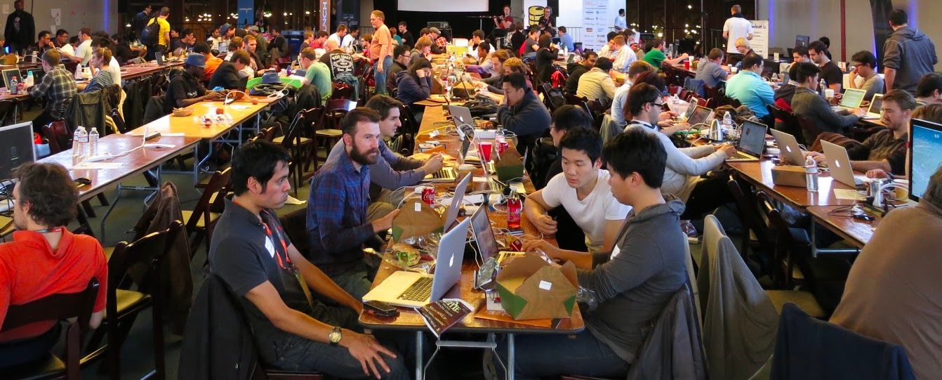
About This Workshop
Emphasis on “workshop”
Notes:
First, a little bit about this workshop. This is a “WORKSHOP”. Which means you need to move your fingers and follow along with the examples. Don’t be passive, you will not learn much just by sitting there and listening. The best way to learn is to actually do it.
*CLICK NEXT SLIDE*

Slide 4
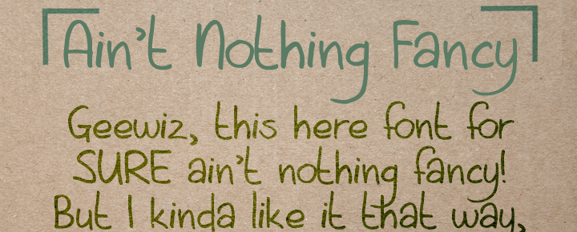
Nothing Fancy Here
But things will still be fun!
Notes:
Just a quick check, who was here for the HTML5/CSS3 workshop last week? This workshop is not going be pretty like that, there’s nothing pretty. The most fancy thing will be my slide transitions, and that’s only for these few slides.
*CLICK SLIDE ADVANCE*

Slide 5
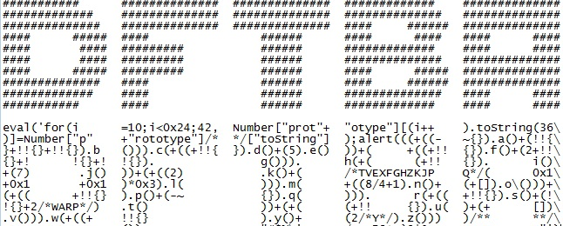
Not touching these
It’s all just text anyway…
Notes:
Git was created with the purpose of managing code, but there will be no code today. Git handles plain text equally well – besides, code is just text anyway! This way, we will not have to bother with bugs and spend hours finding the missing semicolon. So let’s trash this code away!
*CLICK NEXT SLIDE*

Slide 6
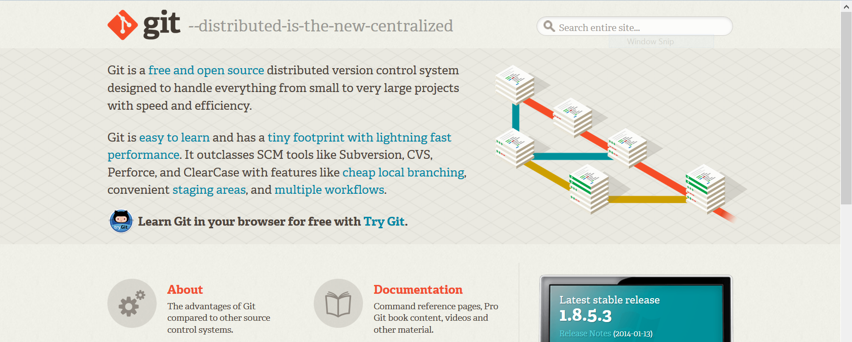
Watches your code, so you don’t have to
Notes:
This is git’s homepage.
*CLICK NEXT SLIDE*

Slide 7

Watches your code, so you don’t have to
Notes:
And it describes itself as a free and open source distributed version control system. Anyone knows what a version control system is?
*PAUSE*
Basically it is just software to help you keep track of your code and its revisions.
*CLICK NEXT SLIDE*

Slide 8
Watches your code, so you don’t have to
Batman (O.O) Gotham, Git (O.O) Your code
Notes:
You can think of it as a Batman for code. Batman watches over Gotham, and Git watches over your code. It is the hero that your code deserves and needs.
*CLICK NEXT SLIDE*

Slide 9
#TODO
Backups
Create repositories
Multiverse
Patch Mode
Time Travel
Move through time
Collaboration
Add and track files
Ignore things
Save your work
Commit messages
View History
See Changes
Multiple dimensions
Move between worlds
Bring things together
Fix conflicts
Undo things
Really undo things
Remote repositories
Workflow, revisited
Clone repositories
GitHub
Push and pull
Notes:
This is what we are going to cover today! Seems like a lot of things, but don’t worry we will take it one step at a time. This table is given in a hand-out which you should have. If you don’t just raise your hand and a facilitator will pass it to you.
*CLICK NEXT SLIDE*

Slide 10



Backups
Creating Repositories (git init)
Multiverse
Patch Mode
Time Travel
Moving Through Time
Collaboration
Adding and Tracking Files
(git add)
Ignoring Things (.gitignore files)
Saving Your Work (git commit)
Commit Messages and You
Viewing History (git log)
Seeing Changes (git diff)
Multiple Dimensions
(git branch)
Moving Between Worlds
(git checkout)
Bringing Things Together
(git merge)
Fixing Merge Conflicts
(git checkout revisited)
Undoing Things (git revert)
Really Undoing Things
(git reset)
Remote Repositories
Workflow, Revisited
Cloning Repositories
GitHub
Push and Pull

Slide 11
4 main ideas today
BACKUPS
MULTIVERSE
TIME TRAVEL
COLLABORATION
Notes:
There are 4 main ideas we want to cover today: backups, multiple universes, time travel, collaboration. Before we dive in…
*CLICK NEXT SLIDE*

Slide 12

Installation
Everyone
Install Git: www.git-scm.com/downloads
Install Sublime Text 2: http://www.sublimetext.com/2
If (Windows Users)
Run GitPad: https://github.com/github/gitpad
Notes:
We need to make sure we have our systems running. We should all have the appropriate Git distribution installed, and optionally Sublime Text 2, or any other sane text editor. If you are on Windows, you probably want GitPad as well, trust me.
*CLICK NEXT SLIDE*
12

Slide 13
Set up - Terminal
Start Menu/Screen
-> type “Git Bash”
Spotlight
-> type “Terminal”
Notes:
We need to set some configurations, so fire up Terminal. On Windows, do this, on Mac, do that, on Linux, your on your own.
*CLICK NEXT SLIDE*

Slide 14

Set up - Git
Tell Git Who You Are
$ git config --global user.name “<your name>”
$ git config --global user.email “<your email address>”
Mac OS X/Linux Users – Tell Git to Use Colours
$ git config --global --add color.ui true
Notes:
Git needs to know whose code it is looking after, so these steps help you identify yourself. And for Mac users, an extra step brings colours into your life.
*CLICK NEXT SLIDE*
14

Slide 15
Set up – Text editors
$ git config --global core.editor “open –t –W”
$ git config --global core.editor “<editor>”
Nothing
Notes:
This last step is for Mac and Linux users. Follow the above steps to tell Git your preferred editor, unless you like using Vim, if you know what Vim is.
*CLICK NEXT SLIDE*
15

Slide 16
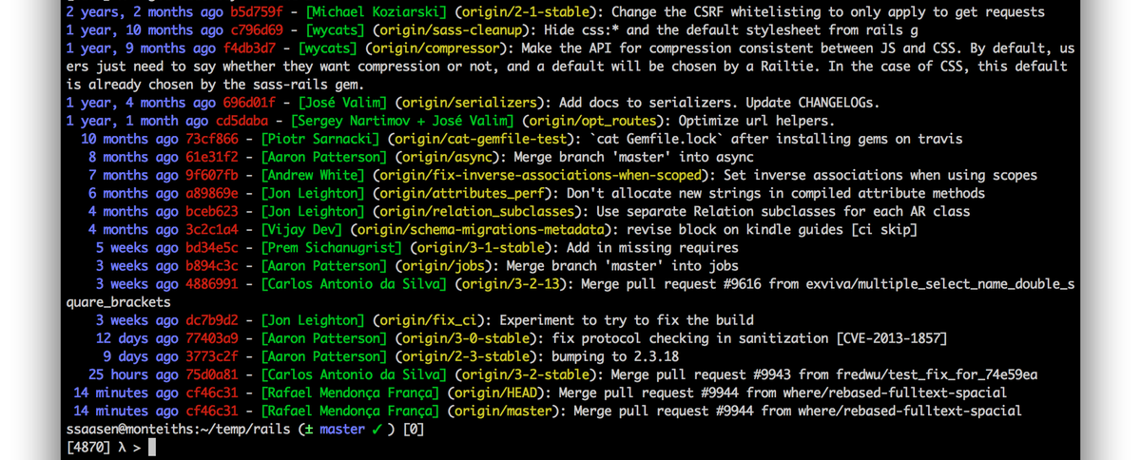

Welcome to the Command Line
Don’t worry, I’ll hold your hand
Notes:
We will be calling command line our home for today. The CLI has many advantages over a GUI: it is simpler, faster, more powerful, and consistent regardless the Operating Systems Git is installed on.
*CLOSE SLIDES*
*CLICK NEXT SLIDE*

Slide 17
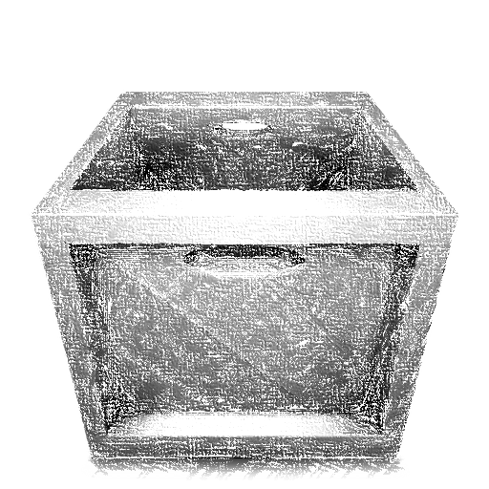
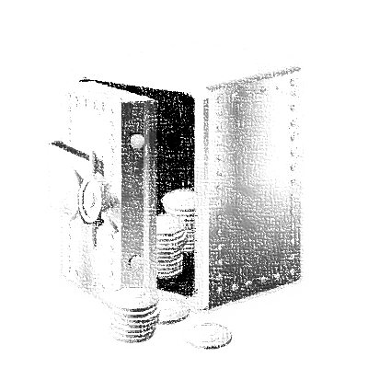
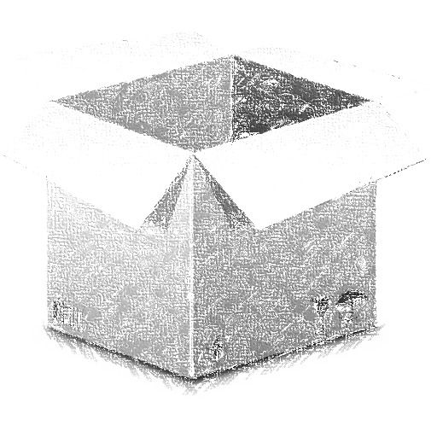
Commits
The “three-box” model
Notes:
Just like life, when we commit to something, we usually want to know more details – in this case, how does a Git commit work? We can think of commits as a 3-box model.
*CLICK NEXT SLIDE*

Slide 18
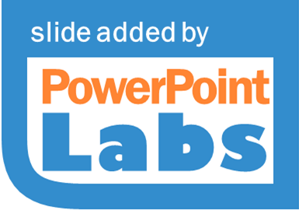
Commits
The “three-box” model

Slide 19

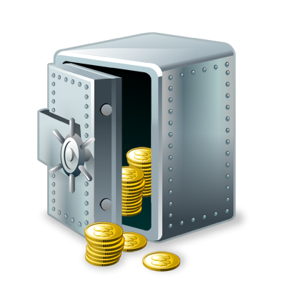

Understanding Commits
repository
staging area
working directory
Notes:
The 3 boxes are the
*CLICK NEXT SLIDE*

Slide 20

Understanding Commits
repository
staging area
working directory
Notes:
Working directory, that’s the folder our file is in, where we are currently editing our file.
*CLICK NEXT SLIDE*

Slide 21

Understanding Commits
repository
staging area
working directory
Notes:
Staging area, an imaginary area Git uses to hold files we are going to commit.
*CLICK NEXT SLIDE*

Slide 22

Understanding Commits
repository
staging area
working directory
Notes:
Repository, where Git actually stores our commits and other information.
*CLICK NEXT SLIDE*

Slide 23

Understanding Commits
$ git commit
$ git add
repository
staging area
working directory
Notes:
In the beginning, there was 1 file in our working directory. When we ran “git add”,
*CLICK*
Git copied the file into the staging area. And when we ran “git commit”,
*CLICK*
it copied the file into the repository.
*CLICK NEXT SLIDE*

Slide 24
What git status does
$ git status
repository
staging area
working directory
Notes:
This is how our 3 boxes look like now, they contain the same things. Run “git status” to verify that there are no changes. What “git status” does is this…
*CLICK NEXT SLIDE*

Slide 25


What git status does
$ git status
repository
staging area
working directory
Notes:
It checks for differences between the working directory and the staging area.
*CLICK NEXT SLIDE*

Slide 26

What git status does
$ git status
repository
staging area
working directory
Notes:
And differences between the staging area and the repository. And reports the differences it found.
*CLICK NEXT SLIDE*

Slide 27

Get into the flow
Change
Stage
Commit
Notes:
To illustrate “git status” more, let’s talk about a simple workflow in Git: Change, Stage, Commit.

Slide 28
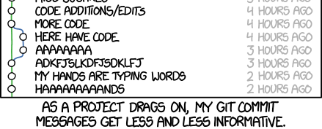
Commit Early, Commit Often
Whenever a meaningful change is made, commit it
Notes:
An important part of Git is committing. A common phrase that goes around is: “commit early, commit often”. This means to commit after every meaningful change. The goal here is to commit small changes, not huge chunks. But why? This is because Git allows us to undo individual commits, which we will learn how to later. If we commit a huge chunk of code, and something breaks, we cannot easily identify what caused the problem. We will then have to dissect the problem manually, which defeats the purpose of having a system to keep track of code in the first place! If you had committed in small portions, Git would allow you to handle the problematic change with a single command. Again, more on that later.
*CLICK SLIDE ADVANCE*

Slide 29
Commit Messages and You
Not so useful
useful
Oops!
lots and lots of changes
asdfasdfasdfasdfasdfasdfadsf
It works!
Fix: Extra image removed.
Moved third party projects to ext folder.
Fix: Fixed bug #1938.
Add: Implemented change request #39381.
(Courtesy of whatthecommit.com and several projects that will remain unnamed.)
Notes:
As we have learned, each commit comes with a message, and the first line of these messages are especially important. It gives a quick overview to the reader what changes were made. Git can show a log of all commits made, and with meaningful messages, we can read the repository like a story book. This means that if you fill the book with garbage, you will read trash. Lets see some examples of messages which are not so useful:
*CLICK*
These messages tell nothing about the commit. It maybe tempting at times to write short messages, for convenience, but meaningful messages really matter, especially when you are working in a team and you will not be the only one looking at your commit messages. Examples of useful messages are:
*CLICK*
These messages tell specifically what changes were made, and even references IDs of bugs or change requests to allow the reader to find more information.
*CLICK NEXT SLIDE*

Slide 30
How to write good commit messages
Present, imperative tense: changed changes change
“Why is this necessary?”
50/72 rule
Notes:
Here are some guidelines to writing good commit messages.
*CLICK*
Use present, imperative tense, change instead of changed or changes.
*CLICK*
Your commit should answer this question, “Why is this necessary?”.
*CLICK*
It should follow the 50/72 rule, the first line is a descriptive header that is less than 50 characters long, followed by a blank line, followed by a detailed explanations that are wrapped at 72 characters.
In short, commit messages are short summaries of what changed.

Slide 31

#DONE #TODO
Backups
Create repositories
Multiverse
Patch Mode
Add and track files
Ignore things
Save your work
Commit messages
View History
See Changes
Multiple dimensions
Move between worlds
Bring things together
Fix conflicts
Notes:
What we have done so far this morning is the basic of Git, just 1 of the 4 main ideas today, but actually the most content intensive one. Actually you can already start using Git. So yes you guys can pack up and go home, or stay on for more juicy Git knowledge. We shall have a break now for 10 minutes, go to the toilet, grab a bite, or practise using Git, the facilitators will be here to assist you.

Slide 32
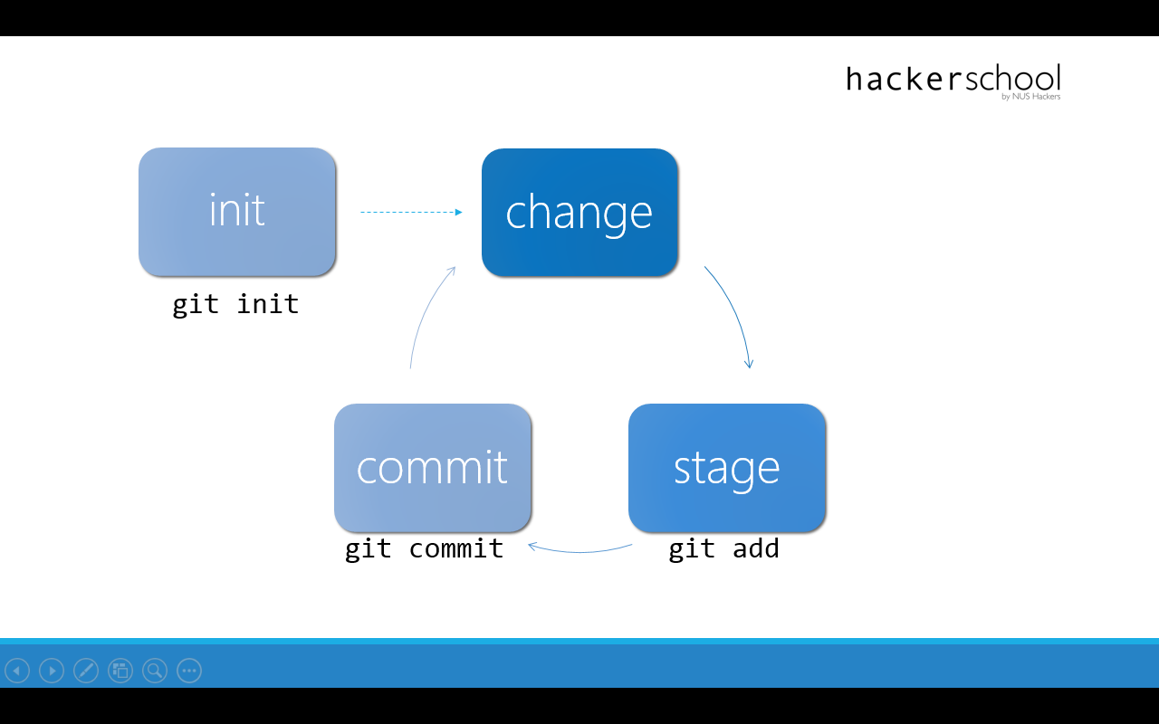
init
change
git init
commit
stage
git commit
git add
Notes:
32

Slide 33
Basic workflow
Δcode
Change
Stage
Commit
Init
Notes:
Welcome back! This is the basic workflow that we saw just now: initialize your repository,
*CLICK*
make small changes, stage those changes, and commit them, with a meaningful message.
As we discussed earlier, it is good practice to commit small changes, but it is also easy to get caught up in coding
*CLICK NEXT SLIDE*

Slide 34
Basic workflow
Δcode
Change
Stage
Commit
Init
Notes:
And end up having written a huge chunk of code
*CLICK*
with multiple features before we actually stop and remember: “Oops I need to commit!” Now do you think the creator/s of Git faced these problems? Yes, which is why he came up with
*CLICK NEXT SLIDE*

Slide 35

Patch Mode
Turning big changes into small commits
Notes:
Patch mode! Patch mode lets us split up big chunks of changes into smaller bits and selectively commit them.
*CLOSE SLIDES*

Slide 36
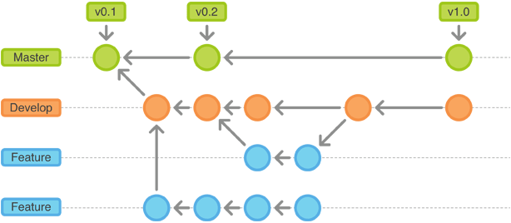
Branching
Multiple dimensions in a single repository
Notes:
Let us explore this idea of Branching. It’s not an exciting name, they could have called it, multiverse, or cross-dimensional space travel, but they chose branching, possibly because it makes your project look like branches. But the gist of it is to let multiple versions of your project coexist in a single repository.
*CLOSE SLIDES*
*CLICK NEXT SLIDE*

Slide 37
Branches Visualised
featureA
master
featureB
TIME
Notes:
To understand branches, it helps to visualize Git repositories. Each circle represents a commit, and the ones on your left are older than the ones on your right. The arrows point to the parent of each commit, so if this commit is the parent of that commit, that commit is based on this commit. And that’s how Git tracks things, by noting these linkages, relationships, between all the commits. And these linkages form a chain, and that is what we call a Branch. If you type “git status” now, what do you see? You’re on branch “master”.
*CLICK*
That is a default branch that a project start out on. The point of having a branch is to have a self-contained universe,
*CLICK*
with commits that only exist in that branch, so it doesn’t interfere with other branches. This means that you can experiment on different things without worrying about breaking your current working software:
*CLICK*
just put them on different branches! They don’t interfere with what you have done, and you can easily drop them if they don’t work out
*CLICK**CLICK NEXT SLIDE*
37

Slide 38
Merging Visualised
*
master
*
master
*
alternate
$ git merge
$ git checkout alternate
$ git checkout master
$ git commit
$ git branch alternate
$ git commit
TIME
Notes:
Let’s try to visualize what happened. We were originally on the “master” branch.
*CLICK*
Then we created the “alternate” branch. We made some changes and committed it,
*CLICK*
so there’s this new blob, and the “master” tag now points to this commit. Note that our commit happens on “master”, and “alternate” has not moved. We then went into “alternate”
*CLICK*
by checking it out. Made a commit,
*CLICK*
this moved the “alternate” tag. Notice that “alternate” has branched out from “master”. We then
*CLICK*
went back into master and
*CLICK*
merged in “alternate”. Notice how “alternate” is still untouched?
38

Slide 39
#DONE #TODO
Multiverse
Patch Mode
Multiple dimensions
Move between worlds
Bring things together
Fix conflicts
Time travel
Moving Through Time
Undoing Things
Really Undoing Things
Notes:
We have explored how Git gives us multiple universes, tried moving across them, merging them, and even making peace when there is conflict. After a 5 minutes break, we will be trying something as exciting: travelling through time.
*CLICK NEXT SLIDE*

Slide 40
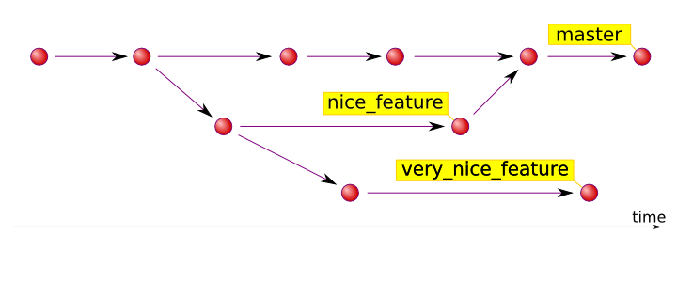
HEAD and checkout
Jumping through branches and time
Notes:
Next up we will look at something called the HEAD, and also use checkout to let us time travel.
*CLICK NEXT SLIDE*

Slide 41
HEAD and checkout
development
HEAD
6h3
2f3
a1b
2c3
d4e
master
1a2
b3c
4de
HEAD
$ git checkout development
experimental
HEAD
$ git checkout experimental
$ git checkout 2c3
Notes:
Here we have a sample repository, not the one we have, this is just for illustration. We have 3 branches, “master”, “development”, and “experimental”. Right now, we are on master, anyone knows how to move to the “development” branch?
*CLICK*
Checkout moves our current position, and it does so by moving this tag called a HEAD. HEAD is a label that points to the commit where we are at. When we want to move to “experimental” we use checkout again, and it moves like this:
*CLICK*
If we take a look at our log, we can see that each commit has an alphanumeric ID associated with it. Something like this
*CLICK*
The cool thing is, we can actually use checkout to move between commits! We can checkout 2c3 to move HEAD to that commit!
*CLICK*
This means that at anytime, we can see previously committed version of our project. Let’s go ahead and try it!
*CLOSE SLIDES GO TERMINAL*
41

Slide 42
Checkout, Revert, and Reset
git checkout <branch|commit>
Moves HEAD to that branch/commit
git checkout <commit> <file>
Takes <file> from the <commit>
git revert <commit>
Undoes the changes made in <commit>

Slide 43
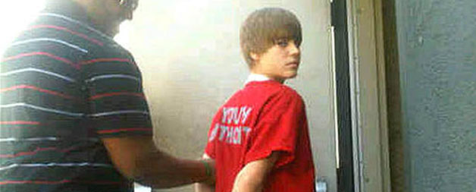
Git Reset
When shit gets out of control
Notes:
What do you do when things spin out of control? When you have made a mess so bad the only way is to restart? You have Git Reset. Git reset is dangerous because it actually alters your commit history. It has potential to cause even more mess, especially if other people are working on your code.
*CLICK NEXT SLIDE*

Slide 44
Reset: Three Modes
git reset <commit> --<mode>
--hard completely drops all (tracked) changes since the specified commit
--mixed drops changes from the repository and staging area, leaves them in the working directory
--soft drops changes from the repository, leaves them in the staging area and working directory
Notes:
We won’t go much into reset, but there are 3 modes to it. The default mode is “mixed”, and the one we’re playing with today is “hard”, the most dangerous and badass reset mode, because we live on the edge.
*CLICK NEXT SLIDE*

Slide 45
git reset --hard
REPOSITORY
STAGING AREA
WORKING DIRECTORY
Notes.txt
Notes.txt
Notes.txt
Notes.txt
Notes.txt
Notes.txt
Notes:
What Git reset hard does is essentially 3 things: it rolls the repository back to the specified commit
*CLICK*
Brings that state into the staging area
*CLICK*
And brings that into the working directory.
*CLICK
What you have now in your working directory is what the specified commit reflects. This means that all changes from the specified commit till now is lost, except for untracked files, those aren’t touched at all.
*CLICK NEXT SLIDE*
45

Slide 46
git reset --hard
a1b
a1b
Notes:
What Git reset hard does is essentially 3 things: it rolls the repository back to the specified commit
*CLICK*
Brings that state into the staging area
*CLICK*
And brings that into the working directory. What you have now in your working directory is what the specified commit reflects. This means that all changes from the specified commit till now is lost, except for untracked files, those aren’t touched at all.
*CLICK NEXT SLIDE*

Slide 47
git reset Visualised
REPOSITORY
STAGING AREA
WORKING DIRECTORY
Notes.txt
--soft
Notes.txt
Notes.txt
Notes.txt
Notes.txt
Notes.txt
Notes.txt
--mixed
Notes.txt
Notes.txt
Notes.txt
Notes.txt
Notes.txt
Notes.txt
Notes.txt
--hard
Notes.txt
Notes:
Just for your info, here are all the modes compared
Again, not covering soft and mixed
Questions again?
<CLOSE SLIDES>
This is actually what all the different modes do. Again, we won’t be covering soft and mixed today.<CLICK>
Does anyone have any questions at this point?
Let’s actually try using it now.
<CLOSE SLIDES>
47

Slide 48
#DONE #TODO
Time travel
Moving Through Time
Undoing Things
Really Undoing Things
Collaboration
Remote Repositories
Workflow, Revisited
Cloning Repositories
GitHub
Push and Pull
Notes:
We just tried travelling through time, and learned that it can be pretty dangerous. We have been working alone for the most of this workshop, but things get more fun when we actually work with other people. So let’s take a break and when we get back we will discuss about collaboration.
*CLICK NEXT SLIDE*

Slide 49

Git with Others
You will never code alone
Notes:
This is the final main idea we are talking about today. We will be looking at how Git works in teams. This is just a pretty quick introduction, you would probably want to explore more on your own.
*CLICK NEXT SLIDE*

Slide 50

Local repository
You
Notes:
So far the situation has been like this: you and a repository on your computer, we call this
*CLICK*
a local repository. When you are working in a team
*CLICK NEXT SLIDE*
50

Slide 51
Local repository
You
Notes:
So far the situation has been like this: you and a repository on your computer, we call this
*CLICK*
a local repository. When you are working in a team
*CLICK NEXT SLIDE*
51

Slide 52


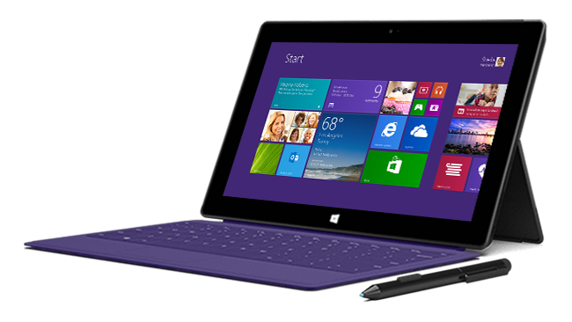
Friend A
You
Friend B
Notes:
Each of you have your own local repository, and somewhere out there,
*CLICK*
you have a remote repository you sync with. To use Git with others, you need to find a host for this remote repository. More on that later.
*CLICK NEXT SLIDE*
52

Slide 53
Lonely workflow
Change
Stage
Commit
Init
Notes:
Let us examine our workflow again. This workflow is for when you are working alone. You initialize a repository, make changes, stage them and commit. It’s kind of lonely, here’s what happens when you throw more people into the workflow.
*CLICK NEXT SLIDE*

Slide 54
Lonely workflow
Change
Stage
Commit
Init

Slide 55
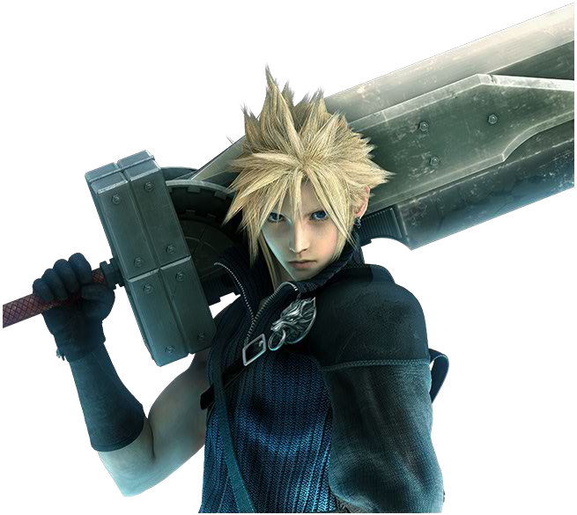




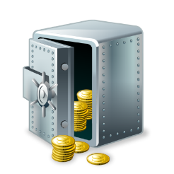

Collaborative workflow
Clone
Init
Pull
Change
Stage
Commit
Push
Notes:
First you have a new thing, the cloud, the remote repository we mentioned just now!
*CLICK*
Oops wrong cloud!
*CLICK*
You can
*CLICK*
clone projects from it, basically make a copy of the project on your computer.
*CLICK*
Pull in changes that aren’t on your local repository.
*CLICK*
Push changes from your local repository to the remote repository. These are independent of your local workflow. You can choose to do those steps at anytime. Let’s take a look at a popular host for remote repositories, GitHub.
*CLOSE SLIDES*
*CLICK SLIDE ADVANCE*

Slide 56
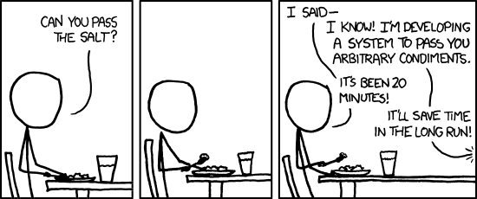
Why aren’t we actually trying this?
You don’t need it (yet.)
Notes:
We aren’t going to delve into Git in teams because you don’t need it now. You should pick it up as you require it. It isn’t difficult because you already know the basics of Git.
*CLICK NEXT SLIDE*

Slide 57
#DONE
Backups
Create repositories
Multiverse
Patch Mode
Time Travel
Move through time
Collaboration
Add and track files
Ignore things
Save your work
Commit messages
View History
See Changes
Multiple dimensions
Move between worlds
Bring things together
Fix conflicts
Undo things
Really undo things
Remote repositories
Workflow, revisited
Clone repositories
GitHub
Push and pull
Notes:
So today we covered 4 main ideas, backups, multiverse, time travel, and collaboration. It’s quite a lot of content, and you probably can’t remember all of it. The most important thing is to practise; keep using Git on all your projects and soon you will be able to master it. That’s the end of this workshop, thank you for coming down today. Don’t forget we have a workshop on Express, a JavaScript web framework, next week, so do sign up for that if you are interested in learning how to build a web application!

Slide 58
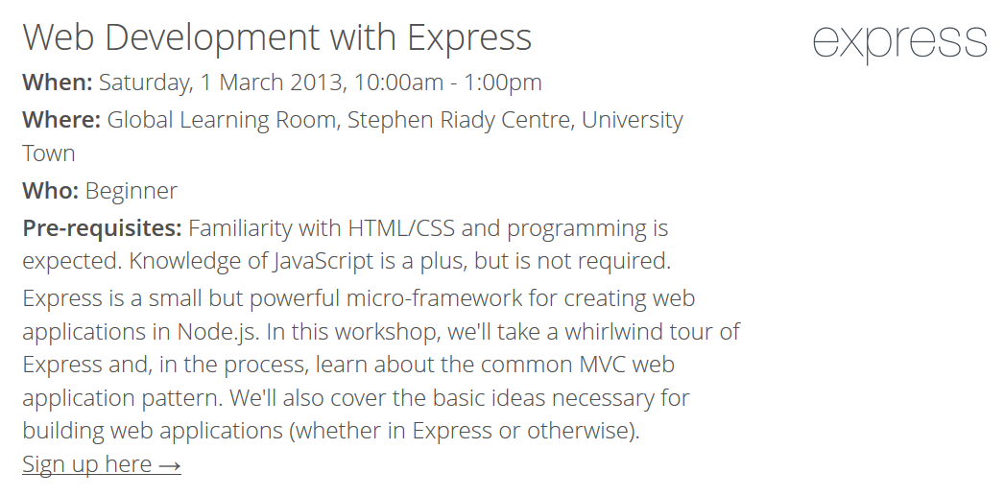

Thank you!
Join us again next week, same time same place!

Slide 59
